Slide 1
Glow Hair Gel
By: Danijel Valić

Slide 2
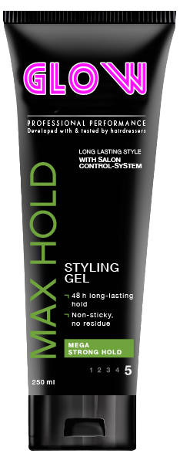
Glow
practicial
invisible
modern
easy to use

Slide 3
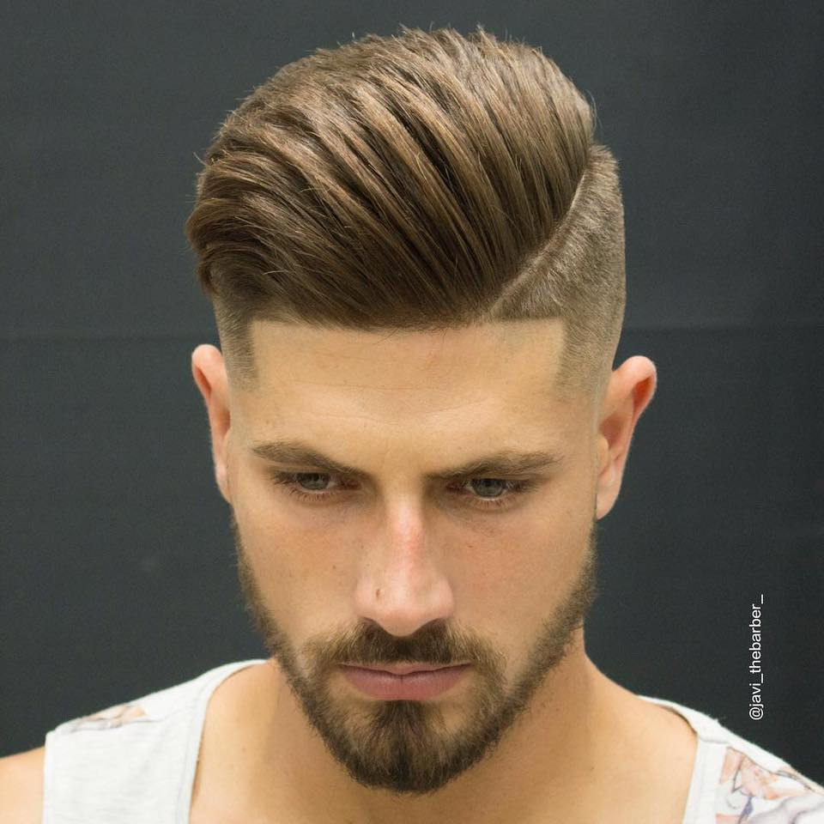
Glow gel is for young men who want to look good
Glow gel is popular with teenagers

Slide 4
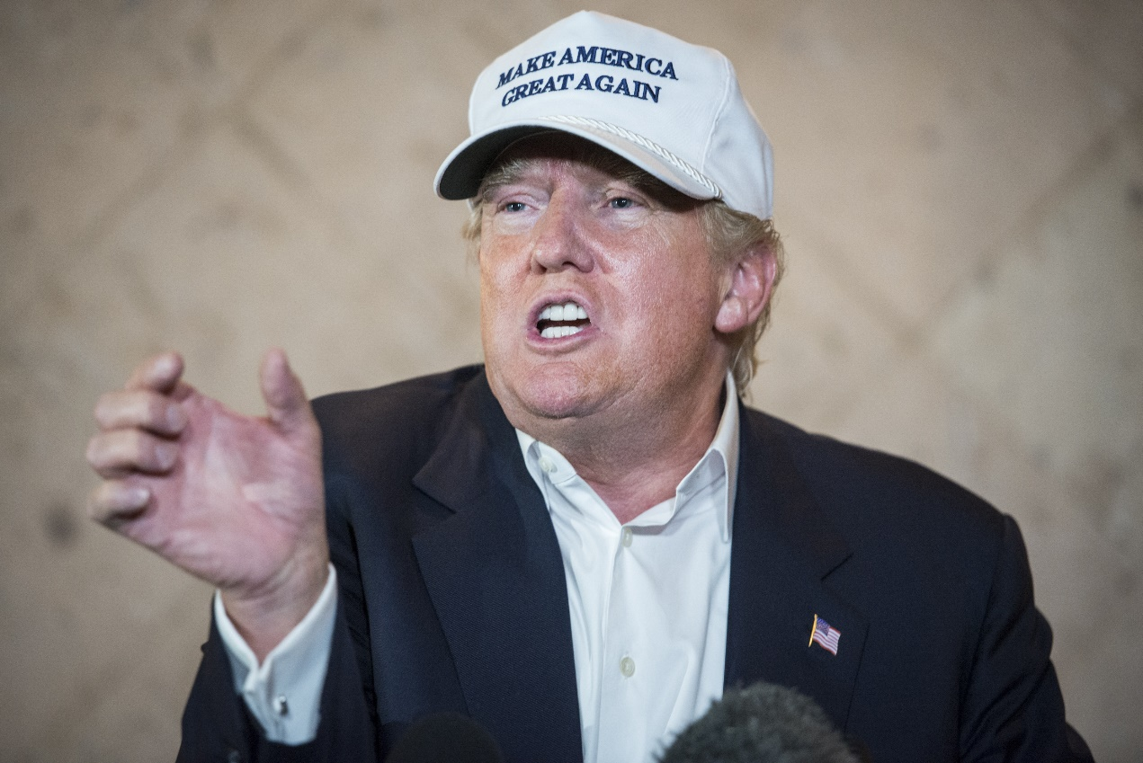
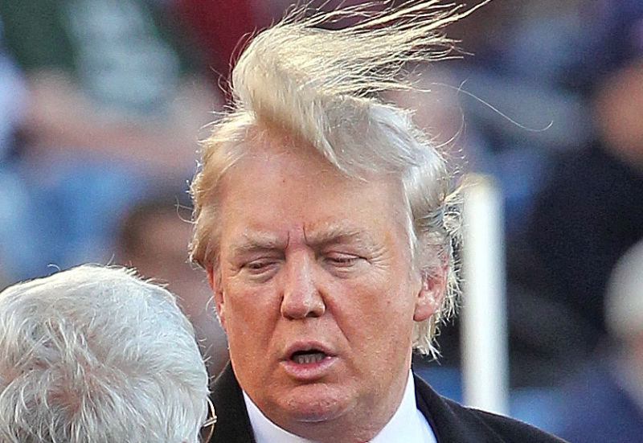
What famous people think about Glow gel?
Famous words from Donald Trump „I know gels. A lot of them are not good. A lot of them are bad; terrible. That’s why I use the best one there – Glow gel.”

Slide 5
Glow
You can find Glow gel at supermarket or online
It will be advertised on televison
Full price is $3.70
But if you call now you can get 50% off

